Slide 1
Operators and Expressions
Dr. Nachiket Tapas

Slide 2
Review
main()
{
int a, b, c, d;
a = 15;
b = 10;
c = ++a - b;
printf(“a = %d b = %d c = %d\n”,a, b, c);
d = b++ +a;
printf(“a = %d b = %d d = %d\n”,a, b, d);
printf(“a/b = %d\n”, a/b);
printf(“a%%b = %d\n”, a%b);
printf(“a *= b = %d\n”, a*=b);
printf(“%d\n”, (c>d) ? 1 : 0);
printf(“%d\n”, (c<d) ? 1 : 0);
}

Slide 3
Output
a = 16 b = 10 c = 6
a = 16 b = 11 d = 26
a/b = 1
a%b = 5
a *=b = 176
0
1

Slide 4
Review
main()
{
float a, b, c, x, y, z;
a = 9;
b = 12;
c = 3;
x = a – b / 3 + c * 2 - 1;
y = a – b / (3 + c) * (2 - 1);
z = a – (b / (3 + c) * 2) - 1;
printf(“x = %f\n”, x);
printf(“y = %f\n”, y);
printf(“z = %f\n”, z);
}

Slide 5
Output
x = 10.000000
y = 7.000000
z = 4.000000

Slide 6
Is the following true?
!(5 + 5 >=10)
5 > 10 || 10 < 20 && 3 < 5
10 ! = 15 && !(10<20) || 15 > 30

Slide 7
Types of operators
Arithmetic operators
Relational operators
Logical operators
Increment and decrement operators
Assignment operators
Conditional operators
Bitwise operators
Special operators

Slide 8
Bitwise Operators
& | Bitwise AND
| | Bitwise OR
^ | Bitwise XOR
<< | Shift Left
>> | Shift Right

Slide 9
Example
#include <stdio.h>
int main() {
int a = 5, b = 9;
printf("%d\n", a&b);
printf("%d\n", a|b);
printf("%d\n", a^b);
printf("%d\n", a<<1);
printf("%d\n", a>>1);
return 0;
}

Slide 10
Special Operators
comma operator
value = (x=5, y=7, x+y);
printf(“%d”, value);
sizeof()
printf(“%d”, sizeof(int));

Slide 11
What is the result?
[ 7 + 8 { 4 × ( 6 + 4 × 3 ) × 4}]

Slide 12
What about this?
45 + 3 { 34 – 18 – 14 } ÷ 3 [ 17 + 3 × 4 – ( 2 × 7 ) ]

Slide 13
Operator Precedence

Slide 14
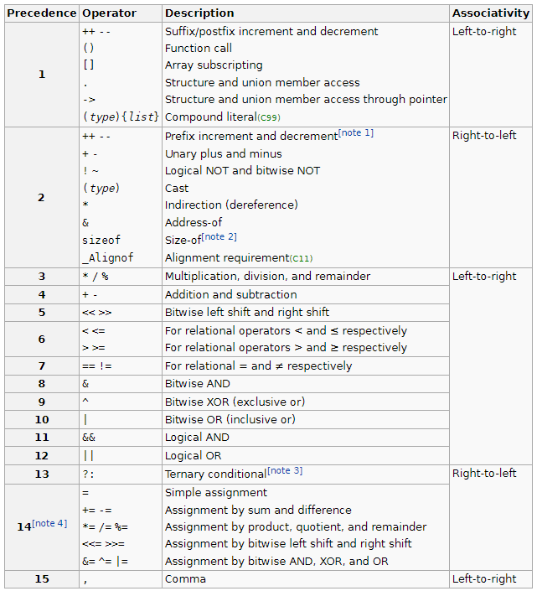
Operator Precedence in C

Slide 15
When to use associativity?
We only use associativity when we have two or more operators that have the same precedence in an expression.
The point to note here is that associativity is not applicable when we are defining the order of evaluation of operands with different levels of precedence.

Slide 16
Example

Slide 17
Example

Slide 18
Example
12 + 3 – 4 / 2 < 3 + 1

Slide 19
Code
#include <stdio.h>
main() {
int a = 20;
int b = 10;
int c = 15;
int d = 5;
int e;
e = (a + b) * c / d; // ( 30 * 15 ) / 5
printf("Value of (a + b) * c / d is : %d\n", e );
e = ((a + b) * c) / d; // (30 * 15 ) / 5
printf("Value of ((a + b) * c) / d is : %d\n" , e );
e = (a + b) * (c / d); // (30) * (15/5)
printf("Value of (a + b) * (c / d) is : %d\n", e );
e = a + (b * c) / d; // 20 + (150/5)
printf("Value of a + (b * c) / d is : %d\n" , e );
return 0;
}
Value of (a + b) * c / d is : 90
Value of ((a + b) * c) / d is : 90
Value of (a + b) * (c / d) is : 90
Value of a + (b * c) / d is : 50

Slide 20
Is the following true?
5 + 5 = = 10 || 1 + 3 = = 5

